Slide 1
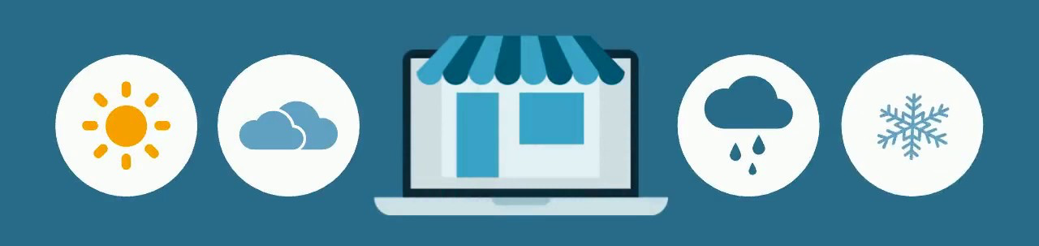
Weather Marketing applications
Using weather conditions to anticipate customer needs

Slide 2
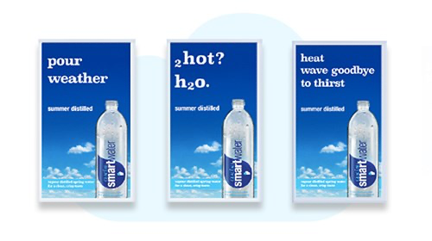
The need for relevance
Anticipating customer needs has always been a priority
Sales cycles are becoming shorter, customers expect relevant offers and communication at all times.
One of the ways to increase personalization, relevance and impact is to use the weather.
Notes:
Weather can be used in 2 ways:
- real-time weather: can be used for communication and real-time product offers.
- weather predictions: can be used for communication but also stocking strategies, for example.

Slide 3
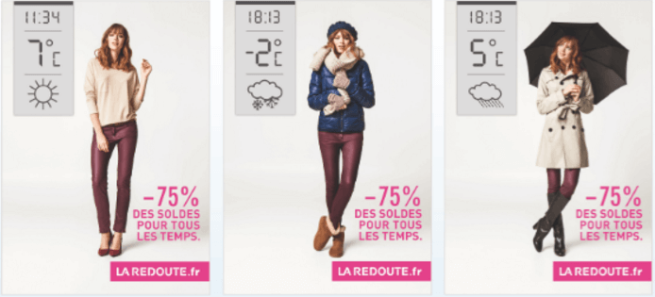
Goal: real-time weather-based offers
I started by gathering the information needed:
A dataset of sales in the UK over 2 years (almost 1M transactions)
Historical records of the weather at the time of the transactions
An API connection to get real-time input of the current weather
I then matched the sales and weather data
And created a product recommender that could potentially recommend the optimal product selection based on the current weather, in real-time.

Slide 4
The issues I ran into:
Very limited information
No product categories (5300+ references)
No link to weather patterns
Revenue was only measure of sales, no profit/other data
Impossible to find another dataset with relevant information on time

Slide 5
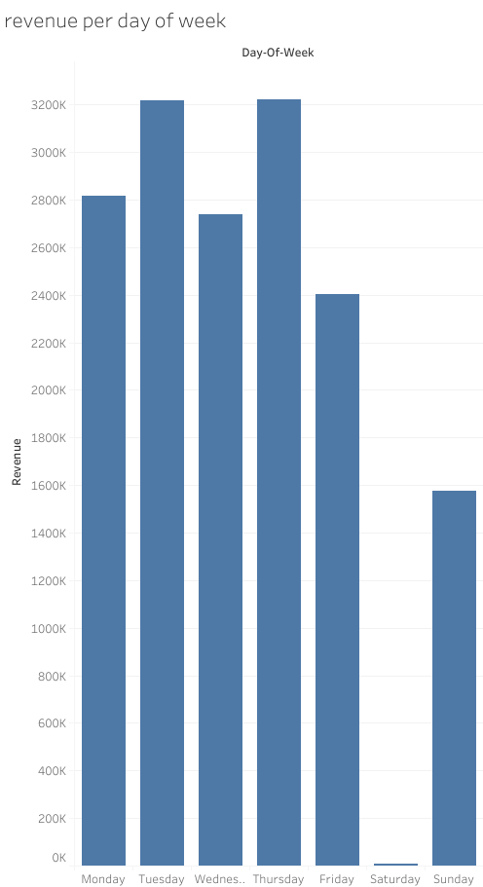
What else did I learn?
No Sales on Saturday
Still half volume of sales on Sunday.
Sales are mostly during business hours
The information points to B2B sales, but that
remains somewhat unclear.

Slide 6
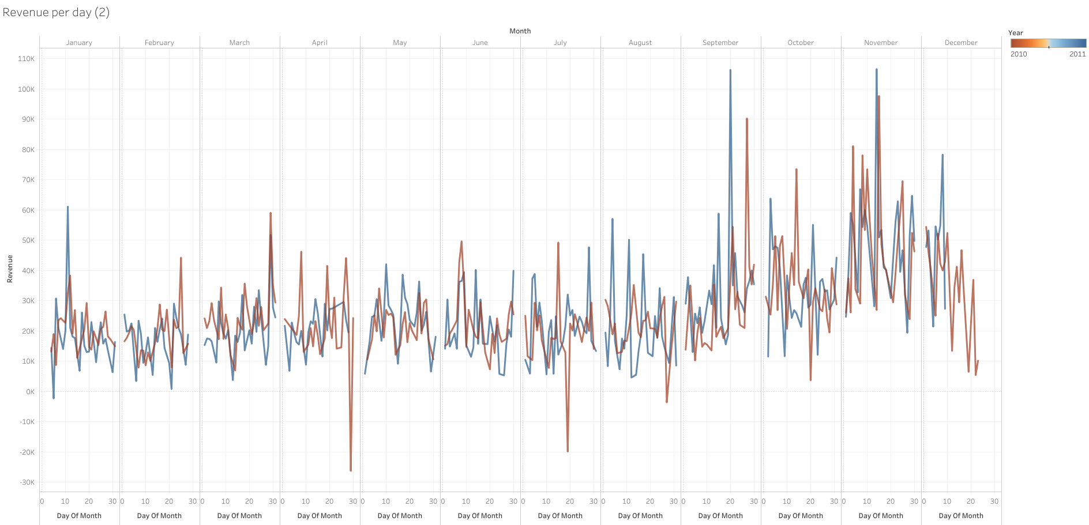
Year-on-year comparison
3 peaks perfectly synchronized (same day or 1 day apart)
4th peak 7 days apart.
Not special days
Notes:
Not special days in the UK so more seasonal (new collection? Or company runs special offers on/around same day each year?)

Slide 7
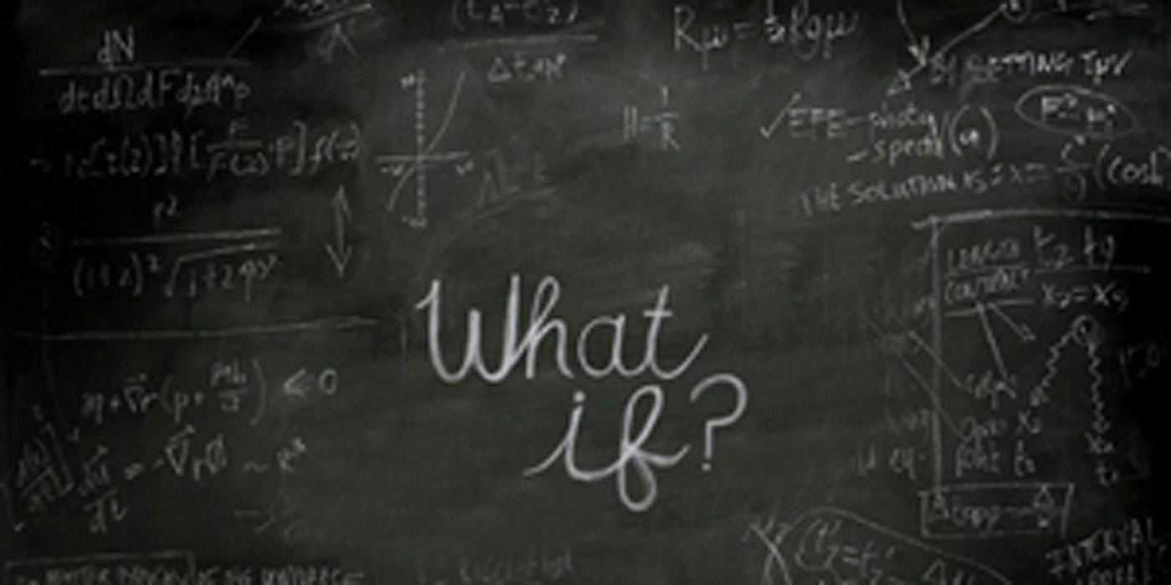
What if I had a different dataset?
What if I was able to model a product selection based on the weather?

Slide 8
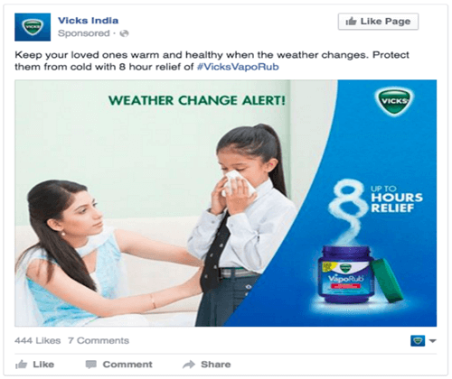
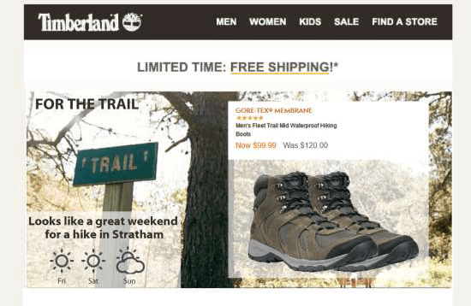
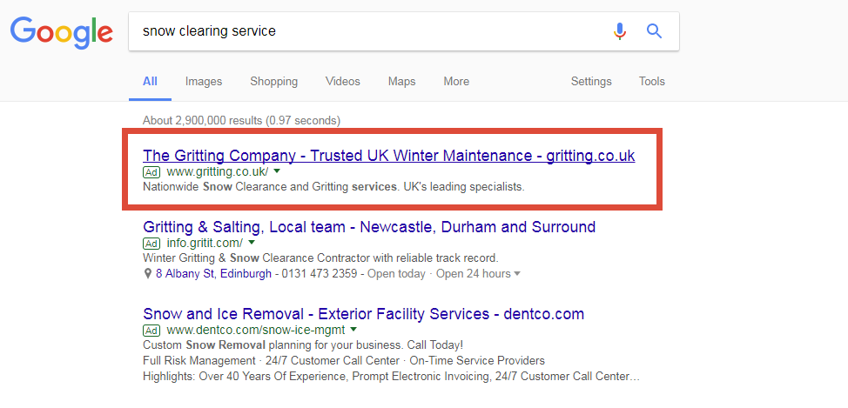
Potential use
This real-time product selection could be used for:
Ticker banners on websites
Product based ads
Social media communication
Targeted media spend

Slide 9
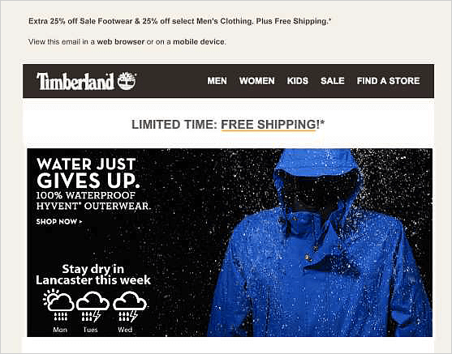
Short to Mid term weather forecasat
While not 100% reliable, weather forecasting has gotten fairly accurate.
This means we can also use a 2 or 3 day forecast to recommend releavant products.
These forecast-based recommendations could be used for:
E-mail marketing
Chosing relevant marketing/ad campaigns
Stocking local stores/organizing supply chain

Slide 10
Beyond the obvious industries…
Rain gear and fashion are obvious places to use weather marketing, but we can look beyond to:
Sports
Taxi/delivery/restaurants
Insurance
Energy
Travel and tourism
Even high tickets items like cars and house sales are affected by weather!

Slide 11
Conclusion
This dataset isn’t suitable for weather-related approach
Weather marketing remains a very interesting topic and relevant in a lot of industries
Rather than blaming the weather for a slump in sales, why not use it to our advantage?

Slide 12
Questions?

